Slide 1

Chatbot Testing Approaches through Mutations
Diego Clerissi
26/01/2023

Slide 2



Open Problems
Conversational flow
NLP-based SW owns distinctive traits w.r.t. traditional SW
Natural language processing
!?
Conversation context
Novel approaches for NLP-based SW validation are needed
  Costly input data preparation to cover real-world scenarios
  Missing/partial oracles due to unpredictable outcomes
…

Slide 3





Main Challenges
Chatbot Mutation Testing: adapt mutation testing techniques to chatbots features and provide a base for experiments on a large scale
Test Cases Generation: generate test cases to effectively exercise chatbots features
The generation of "advanced" input values may require likewise "advanced" oracles to reason over the input variations
Alexa Skills Test Framework
Conga
simulator

Slide 4
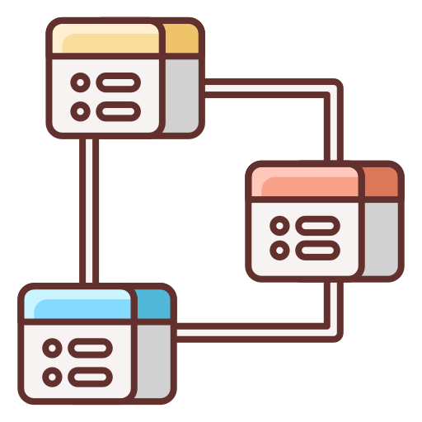



Challenge 1: Chatbot Mutation
Platform-neutral metamodel
Mutation operators identification
Chatbot mutations injection
Mutation operators
Chatbot variants

Slide 5
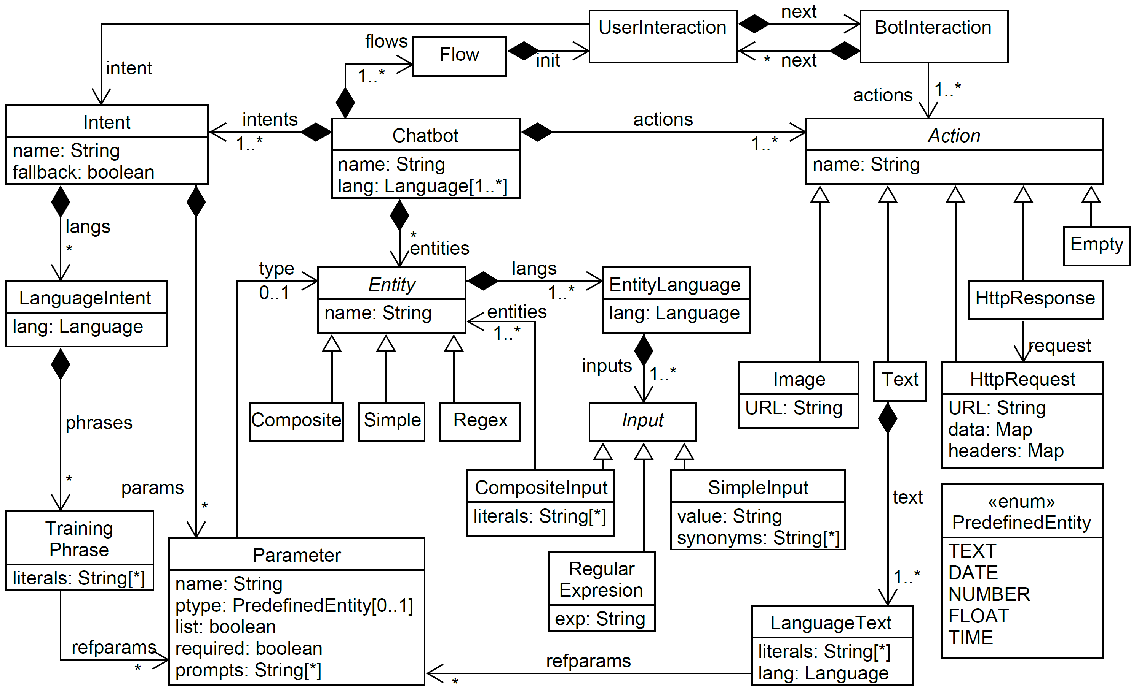
Chatbot Metamodel
Conga is a neutral design notation [1] based on the revision of 15 chatbot development platforms (e.g., Dialogflow, Rasa), used for code generation and design metrics measurements.
The notation is conformant to a metamodel [2], which describes the common features of chatbots.
[1] Automating the measurement of heterogeneous chatbot designs . P. Canizares, S. Perez-Soler, E. Guerra, J. de Lara. SAC 2022.
[2]: Creating and migrating chatbots with Conga. S. Perez-Soler, E. Guerra, J. de Lara. ICSE-Companion 2021.

Slide 6
Chatbot Metamodel

Slide 7
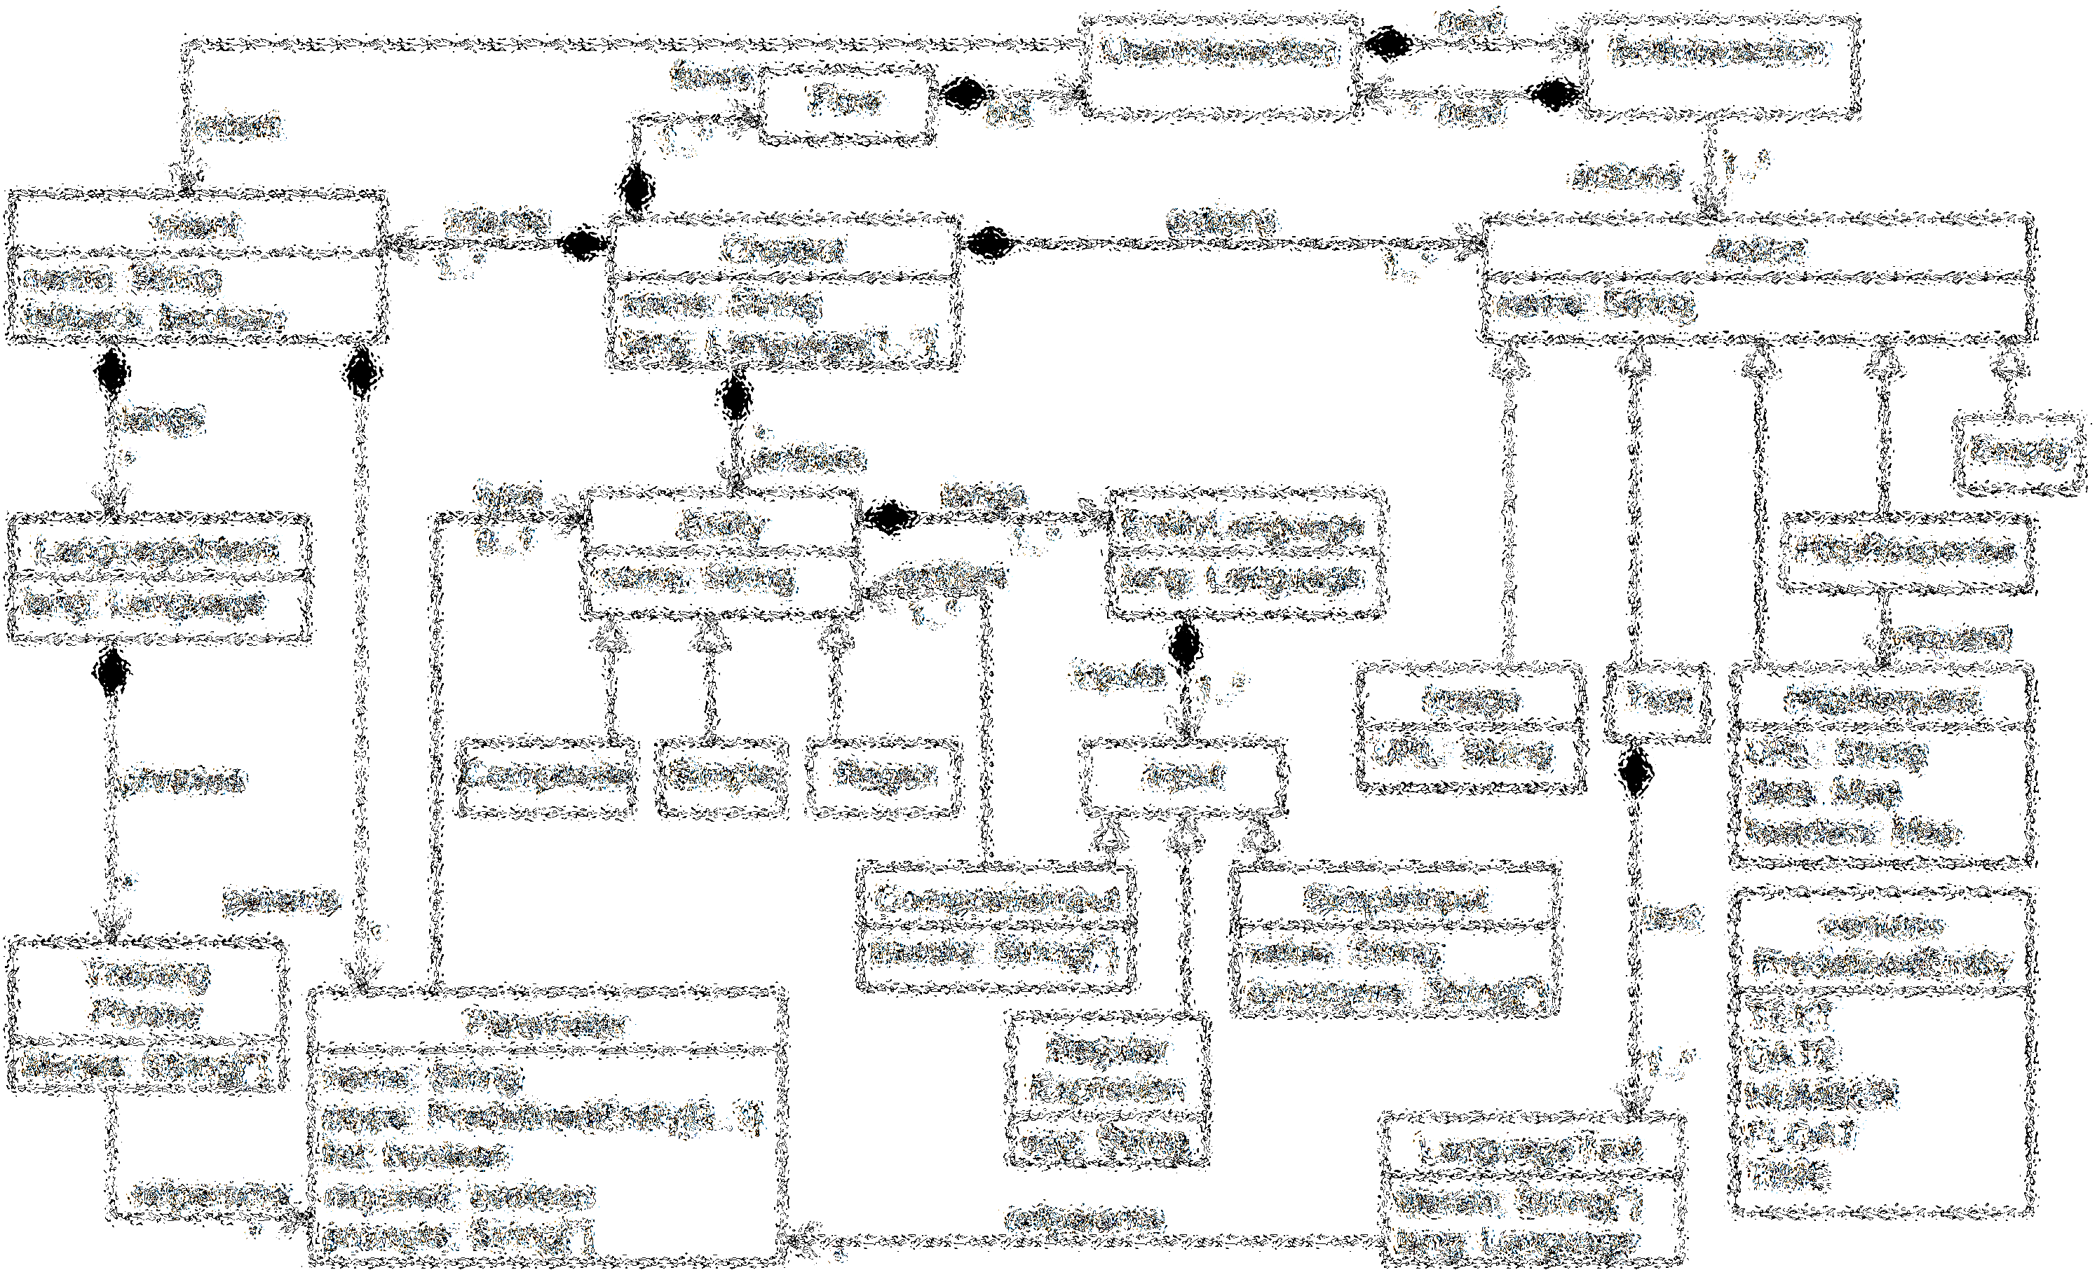
Chatbot Metamodel
A Chatbot is a multi-language object defined as Flows describing the conversation between the user and the chatbot, Intents expressing the user’s interests, Actions performed by the bot in responses to user’s requests, and Entities describing the types of the concepts introduced in the conversations.

Slide 8
Chatbot Metamodel
An Intent can be supported by several languages, and is built up by Training Phrases, that are the ways the user communicates with the chatbot.

Slide 9
Chatbot Metamodel
Training Phrases refer to Parameters, that are typed either by predefined or used-defined Entity objects, which can be Simple, Regex (regular expressions) or Composite, and are associated with Input values.

Slide 10
Chatbot Metamodel
An Action can be of type Text, Image, HttpRequest/HttpResponse (to handle external services), or Empty (to handle platform-specific actions, e.g., GUI-based).

Slide 11
Chatbot Mutation Operators
Mutation Operators
  Driven by the metamodel concepts
    Operators for each class (e.g., Intent), acting over its attributes and associations (e.g., Intent params)
  Defined as combinations of platform-independent & platform-specific steps
    May not be applicable for certain platforms (e.g., mutate a context name in Conga)
  Sorted into structural and semantic operators
    Structural → acting on attributes and associations
    Semantic → acting on values
Conga

Slide 12
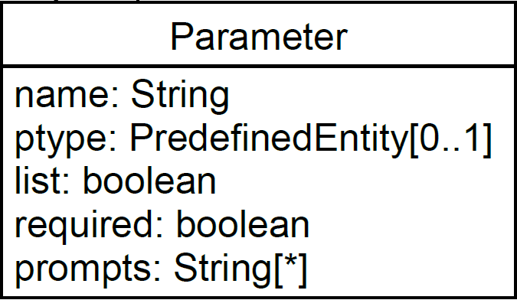
Chatbot Mutation Operators: An Example
removePrompt: Given String prompt and Parameter p, remove prompt from p.prompts
Chatbot v. 1
Chatbot v. 2
…
"parameters": [
{
"id": "625fcf3a-02b2-4780-81f8-7ccb5e0334f9",
"name": "topping",
"required": true,
…
"prompts": [{"value": "Please provide toppings"}]
}
…
]
…
…
"parameters": [
{
"id": "625fcf3a-02b2-4780-81f8-7ccb5e0334f9",
"name": "topping",
"required": true,
…
"prompts": []
}
…
]
…
Dialogflow

Slide 13
Challenge 2: Test Cases Generation
Extending/Generating test cases for chatbots via mutations
  Inspired by Charm [3] chatbot testing tool, aimed at augmenting Botium [4] test cases for Dialogflow chatbots via mutations (e.g., characters swappings, translation chains, synonyms substitutions)
Additional mutations
  Fuzzing (e.g., anomalous long text)
  Security (e.g., changing user context/scope to remove someone’s else reservation)
  Keyword-based interactions (e.g., "time today London")
  Slang-based interactions (e.g., "za and coke 4 2")
  Negative form (e.g., "I don’t want a coke" → "I do want a coke")
  …
simulator
Alexa Skills Test Framework
[3]: Testing chatbots with Charm. S. Bravo-Santos, E. Guerra, J. De Lara. QUATIC 2020.
[4]: Botium. https://botium-docs.readthedocs.io/en/latest/

Slide 14
Test Cases Generation: An Example
Test case v. 1
Test case v. 2
#me
I want a pizza for tonight
#bot
OK, what kind of pizza do you want for tonight?
#me
I want a pepperoni pizza, thanks
#bot
Got it, do you want some drink?
#me
No, thanks
#bot
Pepperoni pizza is ready. Where to deliver?
#me
4426 Southside Lane, Oakland
#bot
Alright, food is coming
…
#me
Za tn
#bot
OK, what kind of pizza do you want for tonight?
#me
I want a pepperoni pizza, thanks
#bot
Got it, do you want some drink?
#me
No, thanks, just veggie pizza
#bot
Wanna change into veggie pizza? Where to deliver?
#me
Yes, I want veggie pizza. Deliver to 4426 Southside Lane
#bot
Ok. What about the city?
…
Rephrase as slang
Intent detected
Botium
Context change
Context change detected
Parameter removal
Missing parameter detected

Slide 15

Ongoing/Future Work
Definition & Implementation of chatbot mutation operators
  Platform under examination: Dialogflow, Rasa, Conga
Implementation of strategies for NLP-based test cases generation (input + oracles)
  Software under examination: Alexa skills, Botium
Meta-model adaptation to address additional platforms

