Slide 1


Who am I ?
Prof. Davide Di Ruscio
Associate Professor
Department of Information Engineering
Computer Science and Mathematics
University of L’Aquila
http://www.di.univaq.it/diruscio
@ddiruscio
Main research fields
Software Engineering, Model Driven Engineering (MDE)
domain specific modelling languages
model management
recommender systems
Main research activities
Working on different European and Italian research projects by contributing the application of MDE concepts and tools in several application domains (e.g., service-based software systems, autonomous systems, open-source software systems, and hybrid polystore systems).
Community services
Reviewer of many journals like IEEE Transactions on Software Engineering, Science of Computer Programming, Software and Systems Modeling, and Journal of Systems and Software.
In the editorial board of the International Journal on Software and Systems Modeling (SoSyM), of IEEE Software, of the Journal of Object Technology, and of the IET Software journal.

Slide 2
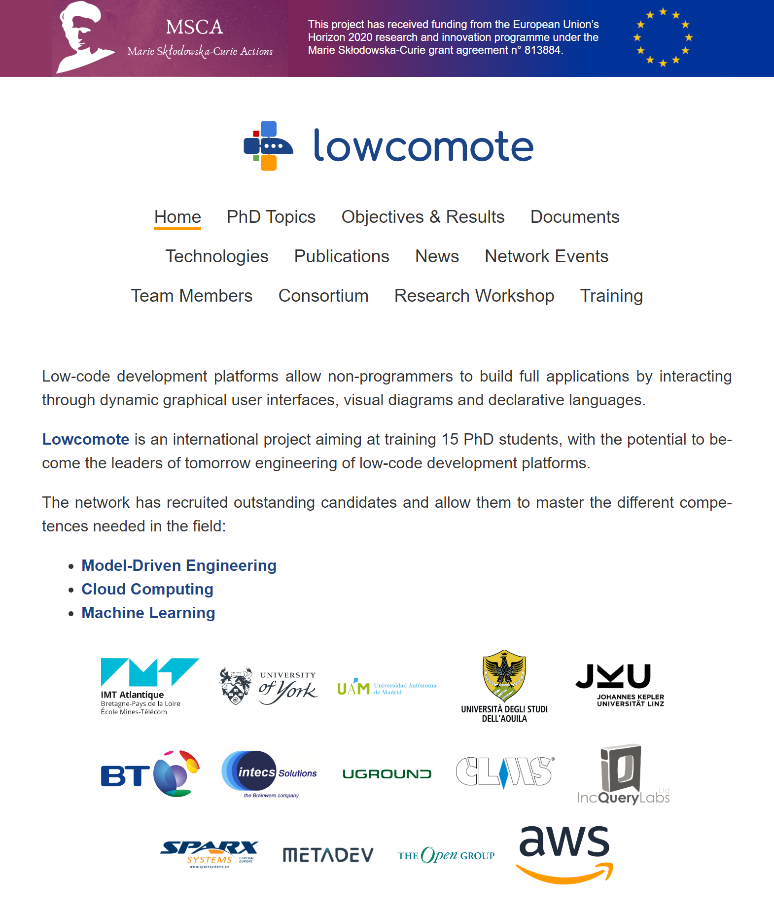

Slide 3
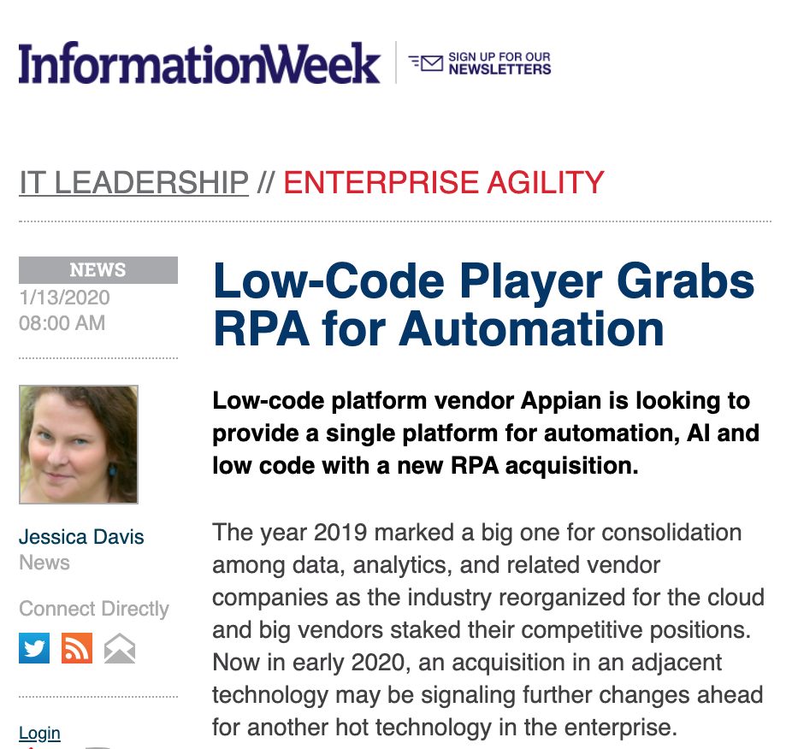
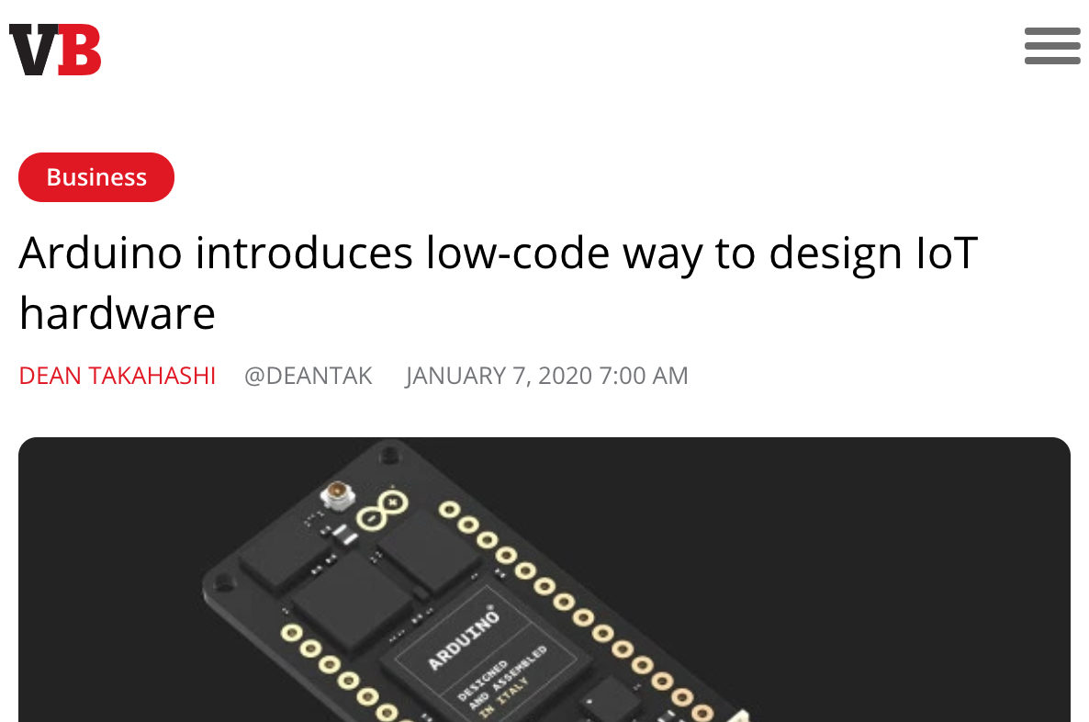
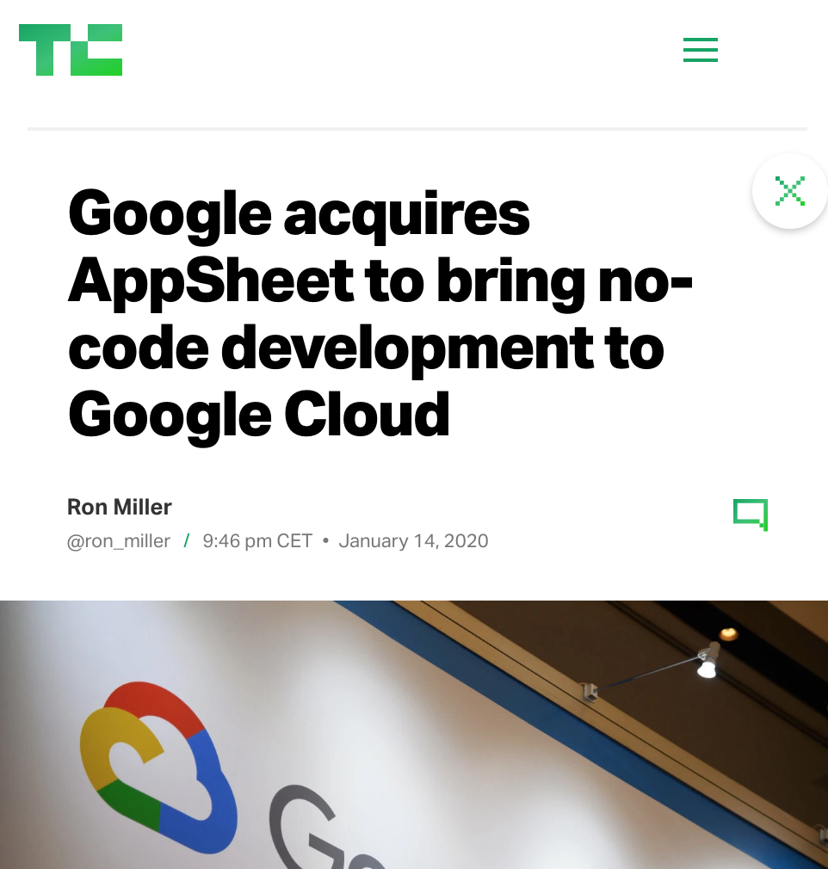
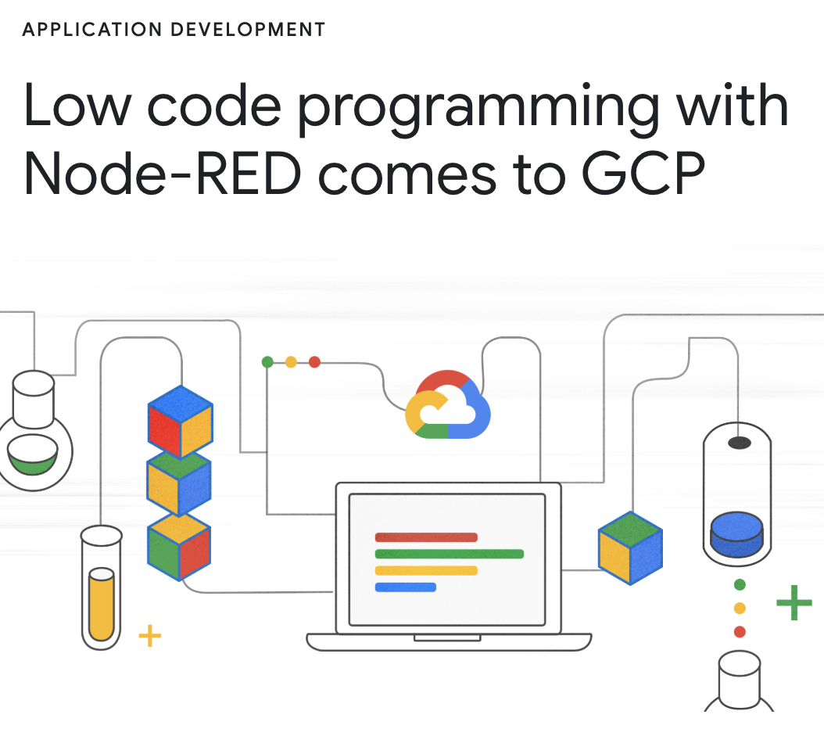
Low-Code in the 2020 News

Slide 4
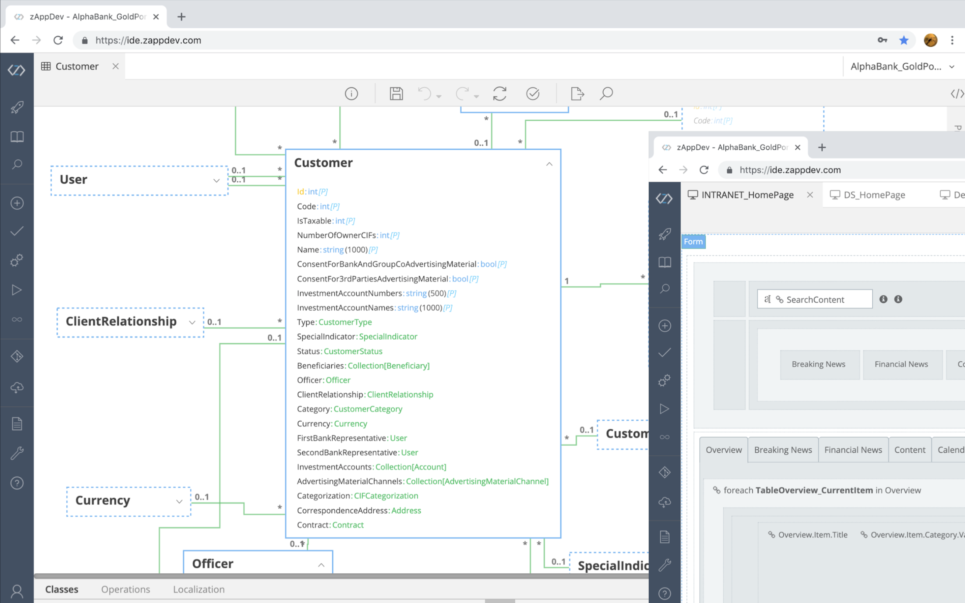
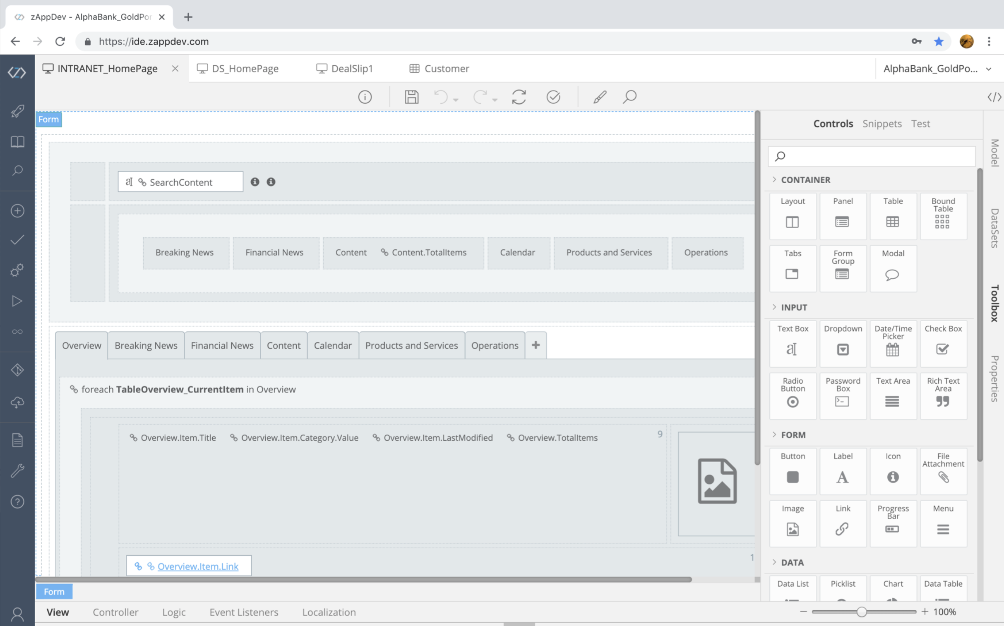
Low-Code Development Platforms (LCDPs): Definition
Platforms for application development that employ visual, declarative techniques instead of programming, and require minimal upfront investment in setup, training, and deployment.
Example (zAppDev by CLMS)

Slide 5
The need for LCDPs
The Developer Gap
  Experienced developers are hard to find
  Offshore sourcing slows down delivery
Systems of Engagement
  Customer journey via more personalized interactions
  More need for customized business applications
Shadow IT
  IT departments are overwhelmed
  Employees install (or develop) software on their own
  This software is not tracked by the company (no security/policies/maintenance)

Slide 6
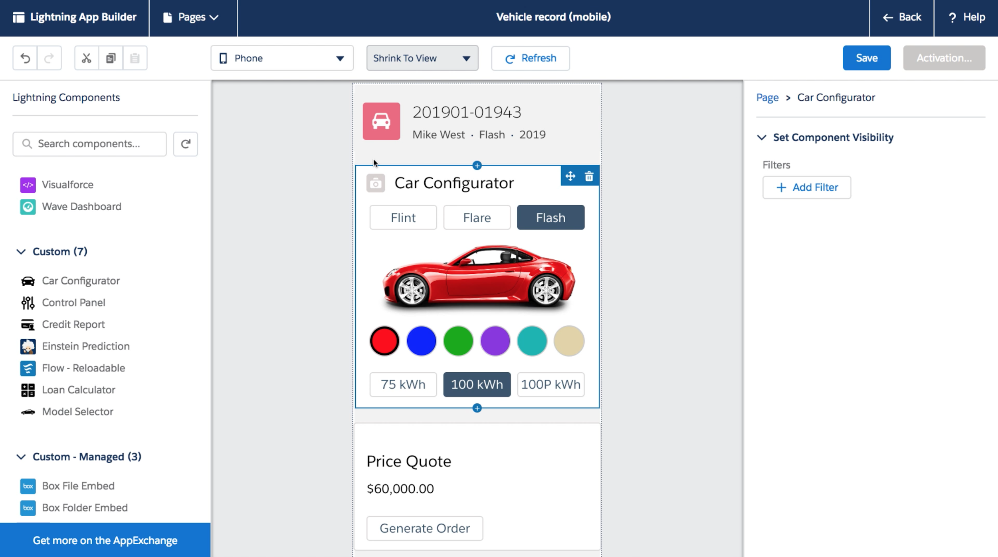
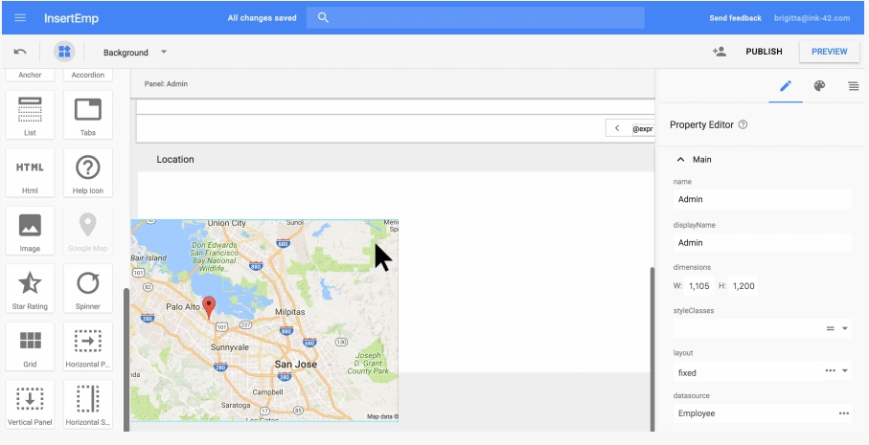
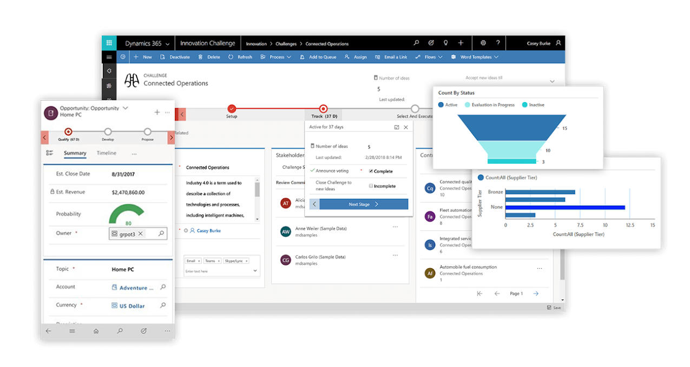
The proliferation of LCDPs
144 LCDPs today, mostly non-European, $21 billion market forecast in 2022
[G2, Jan 2020, https://www.g2.com/categories/low-code-development-platforms]
Salesforce
Lightning
Google
App Sheet
Microsoft
PowerApps

Slide 7
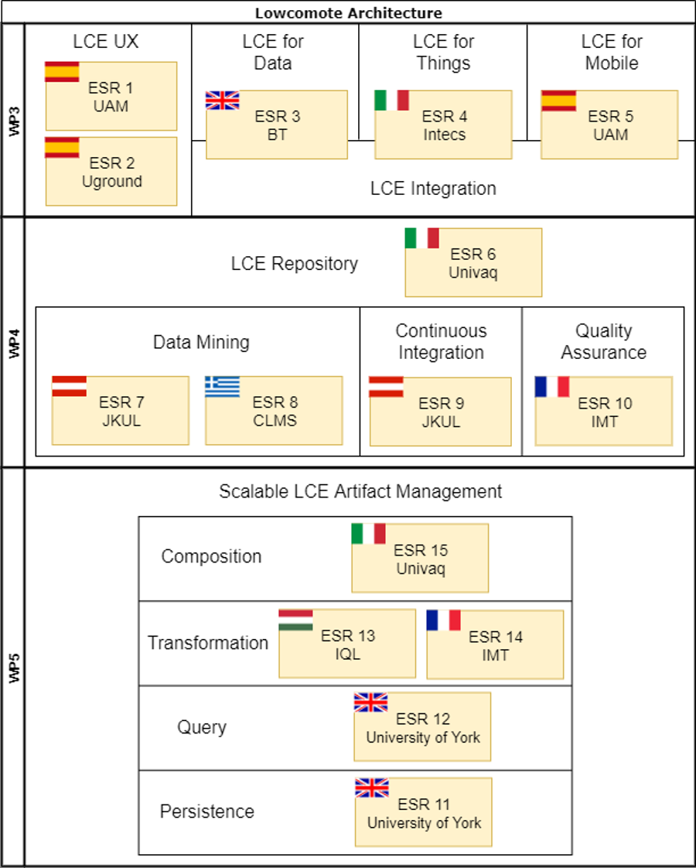















Lowcomote
Training the Next Generation of Experts in Scalable Low-Code Engineering Platforms

Slide 8
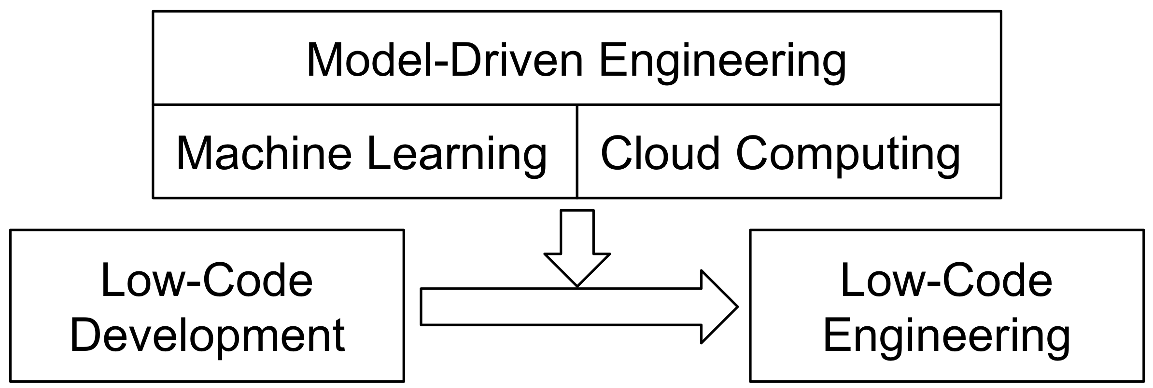
The scientific objective of Lowcomote
Scalable | To large applications, repositories, user communities (on top of EC FP7 MONDO)
Open | Open-source platform to simplify the creation of new LCEPs and avoid fragmentation and vendor lock-in. Based on standards like EMF, LSP, OpenStack
Heterogeneous | Applicable to engineering disciplines
8

Slide 9
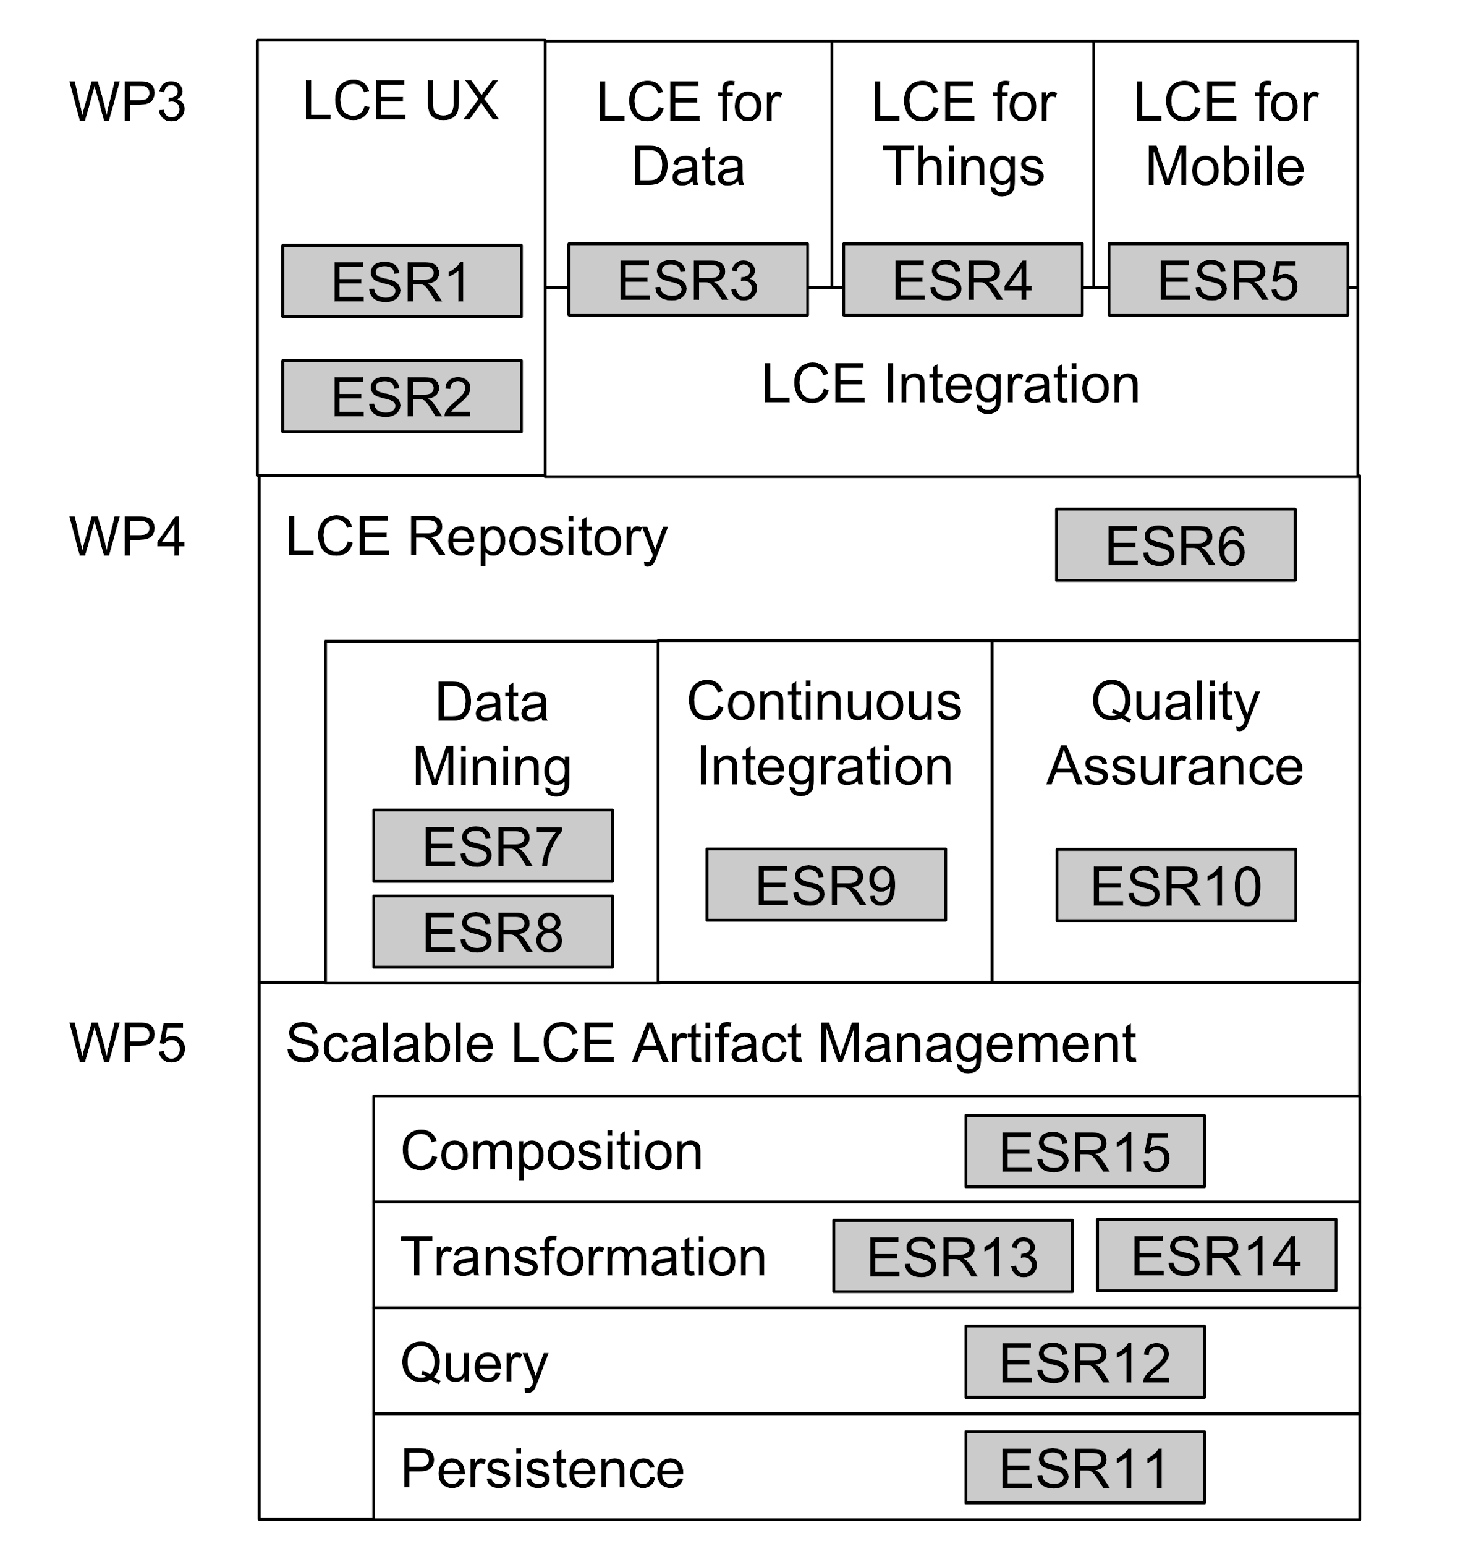
The Lowcomotive open platform
https://github.com/lowcomote
Low-code Engineering of Large-Scale Heterogeneous Systems
Large-scale Repository and Services for Low-Code Engineering
Scalable Low-Code Artifact Management

Slide 10
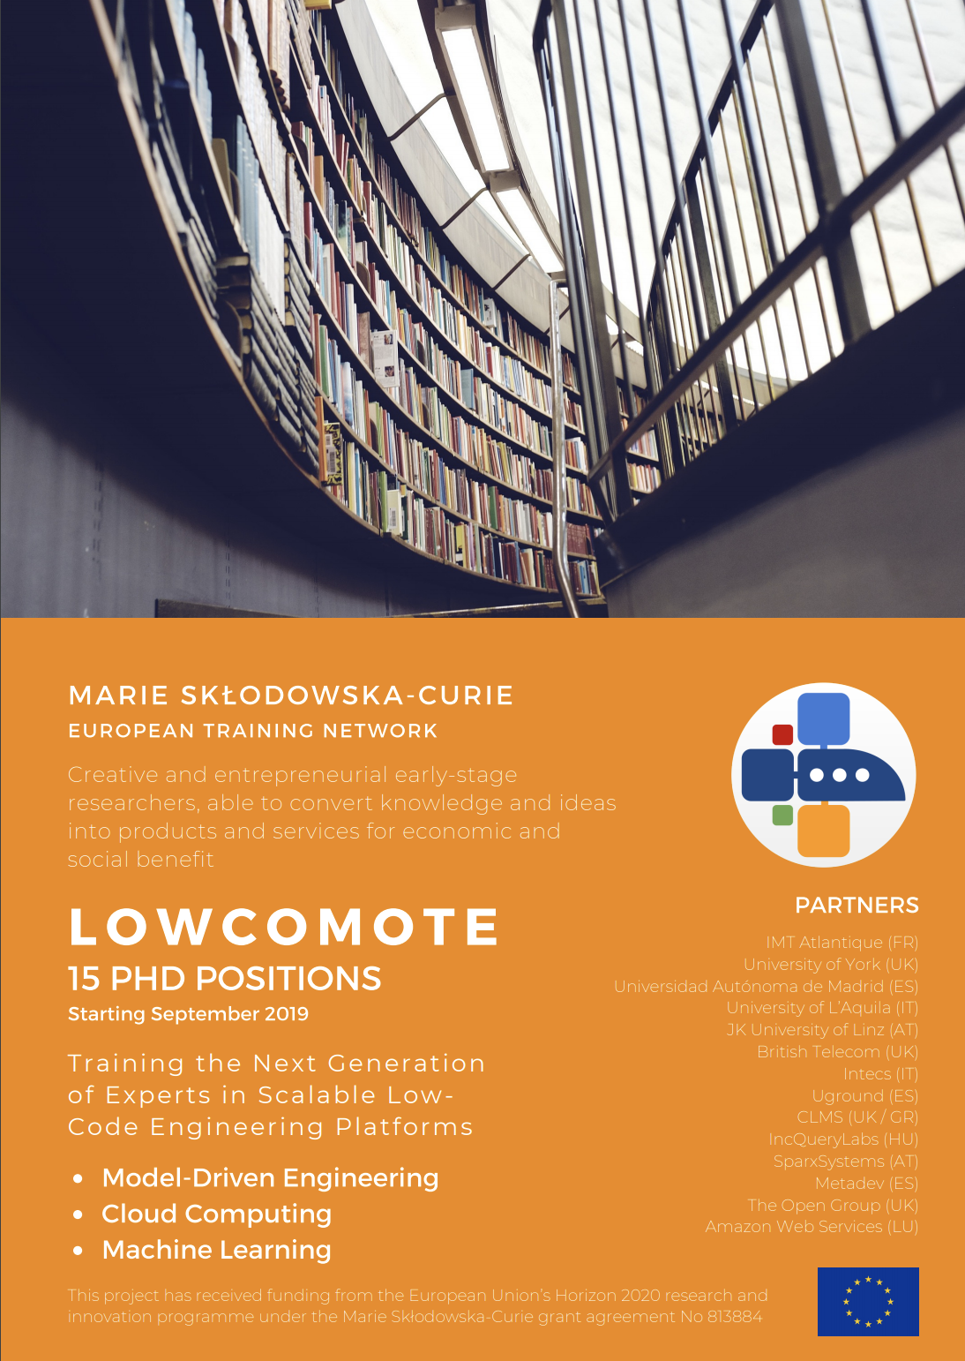
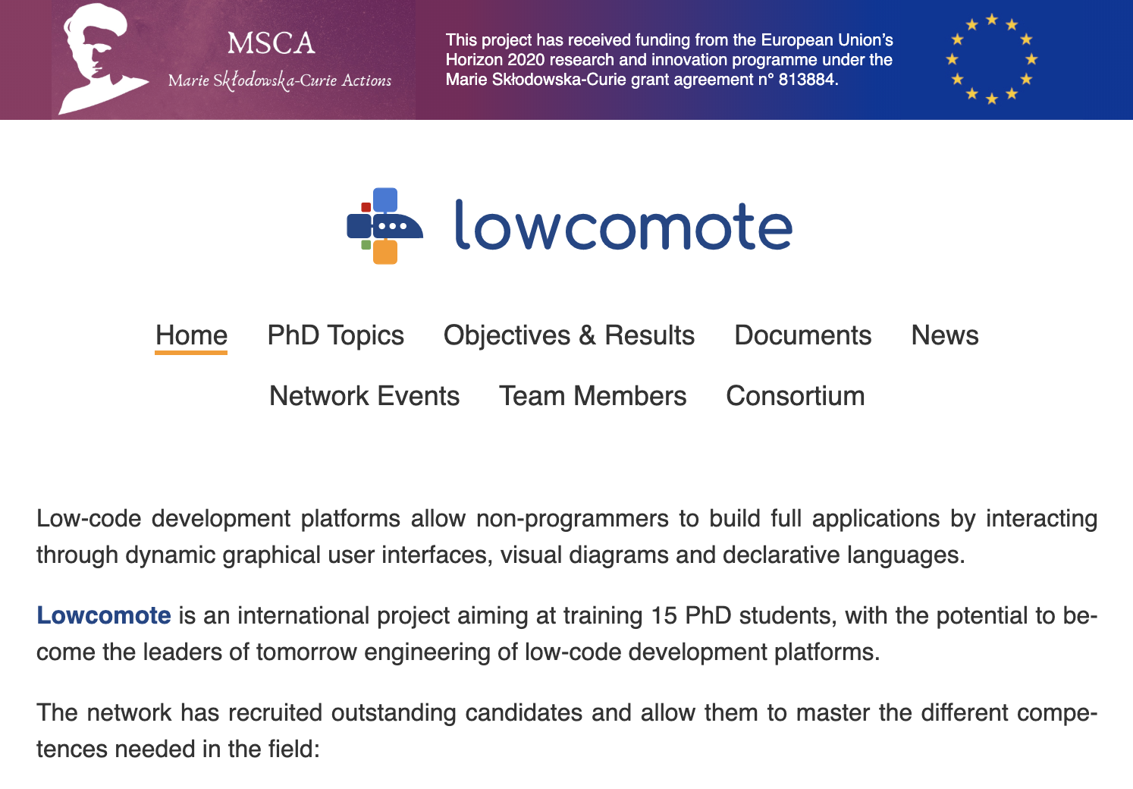
Recruitment
Flyer for project recruitment:
Twitter: https://twitter.com/lowcomote
Project website: https://www.lowcomote.eu/

Slide 11
Recruitment
15 ESRs recruited
Centralised process (except UY & UDA)
Publication of vacancies for minimum 8 weeks
Open, transparent, impartial and equitable process
Advertisement through 10 world-wide job search websites, 19 e-mailing lists, a flyer, 76 Directors of Master Degrees in Computer Science & Software Engineering in Europe + local advertisement
Recruitment process in 2 steps: 1) shortlisting 2) interviews (2 rounds)
209 applicants (710 applications, since the majority of candidates applied for several positions)

Slide 12
The Lowcomote ESRs
Los Lowcos!
ESRs from 4 continents, Europe and Asia the most represented
Africa
ESR4: Félicien Ihirwe (INT)
ESR6: Arsene Indamutsa (UDA)
Asia
ESR2: Fatima Rani (UGD)
ESR7: Safia Kalwar (JKUL)
ESR10: Faezeh Khorram (IMTA)
ESR11: Sorour Jahanbin (UY)
ESR12: Qurat Ul Ain Ali (UY)
ESR15: Apurvanand Sahay (UDA)
Americas
ESR1: Lissette Almonte Garcia (UAM)
Europe
ESR3: Panagiotis Kourouklidis (BT)
ESR5: Léa Brunschwig (UAM)
ESR8: Ilirian Ibrahimi (CLMS)
ESR9: Alessandro Colantoni (JKUL)
ESR13: Benedek Horváth (INQ)
ESR14: Jolan Philippe (IMT)

Slide 13
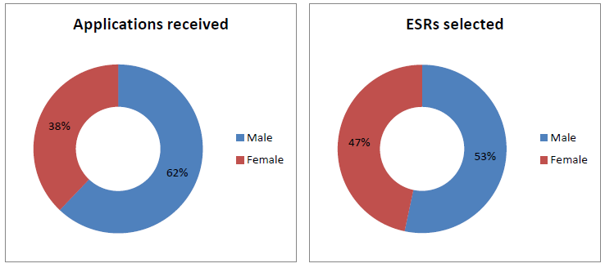
Gender balance

Slide 14
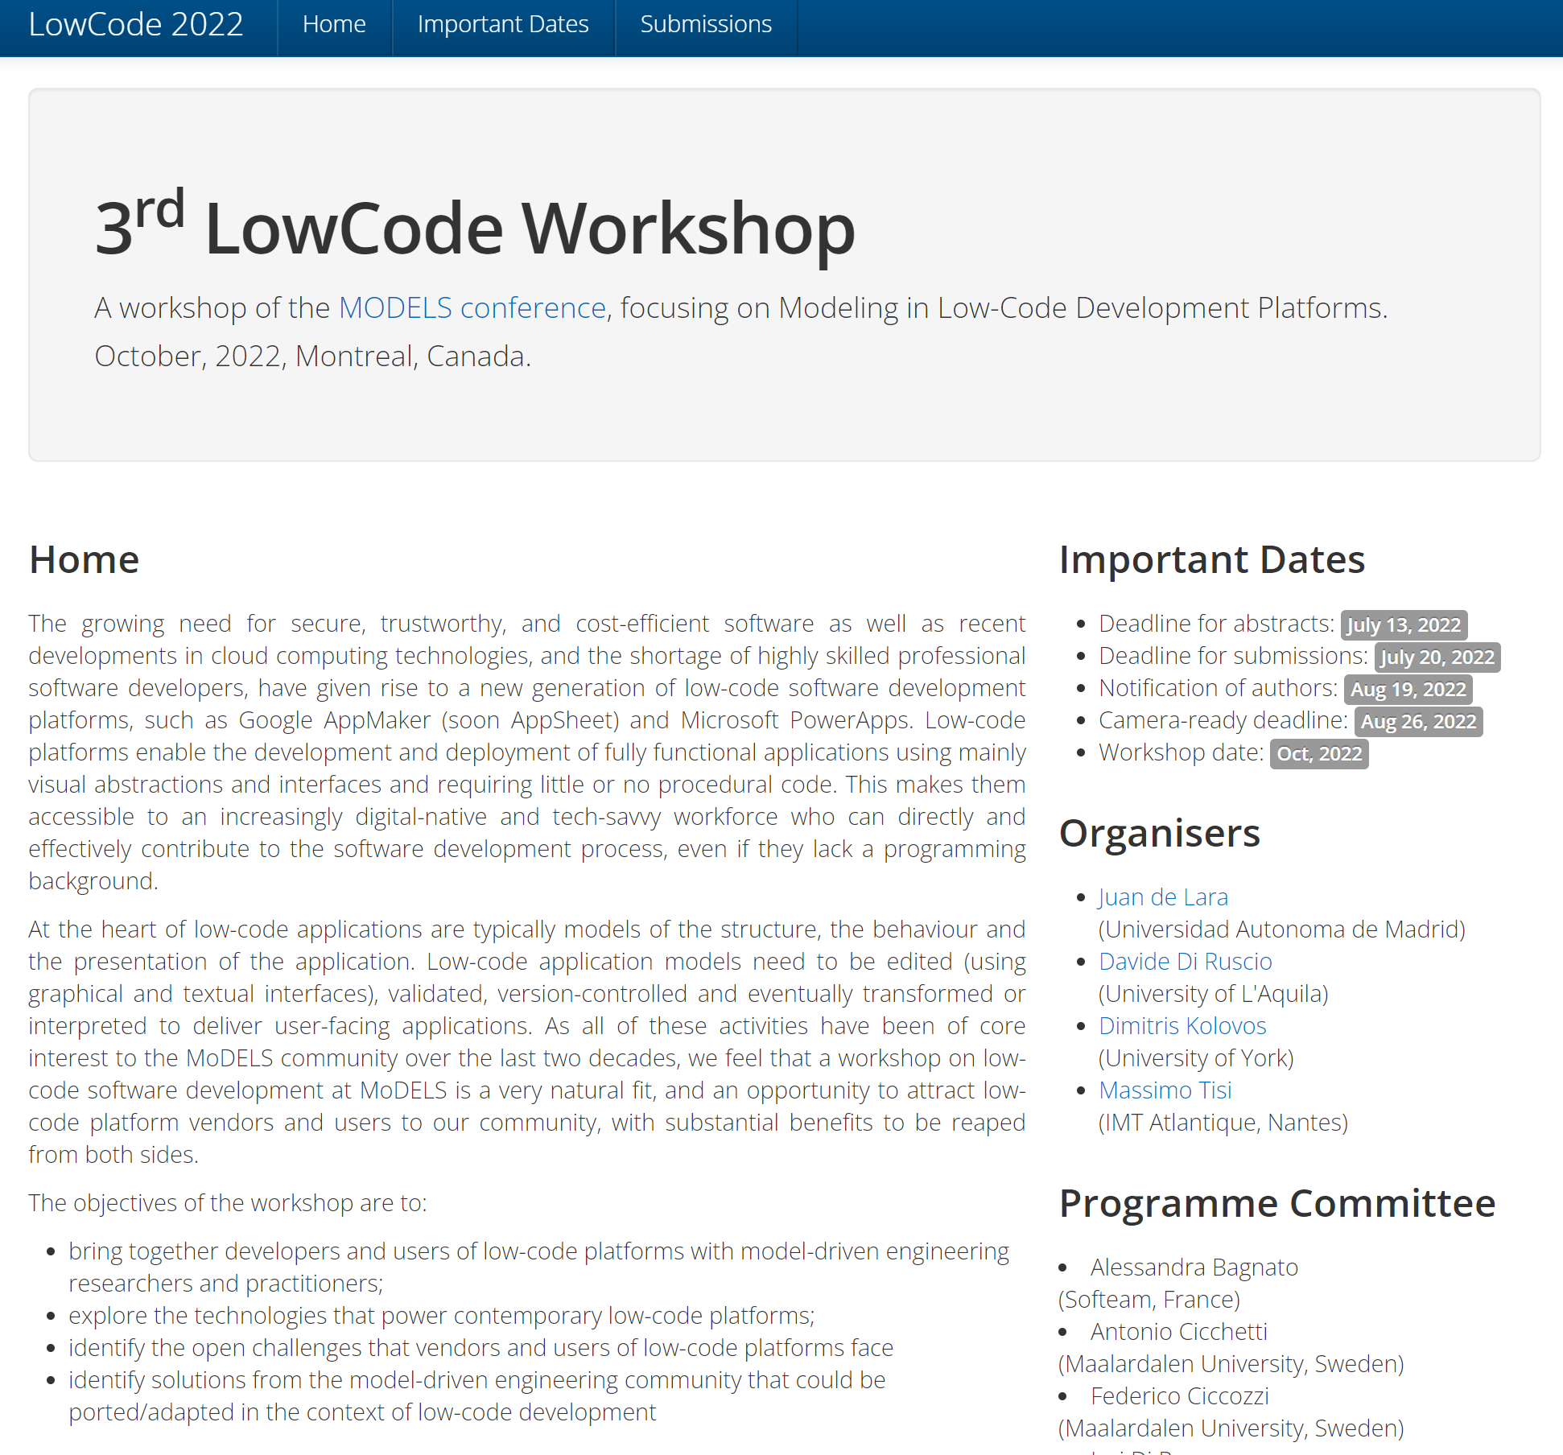
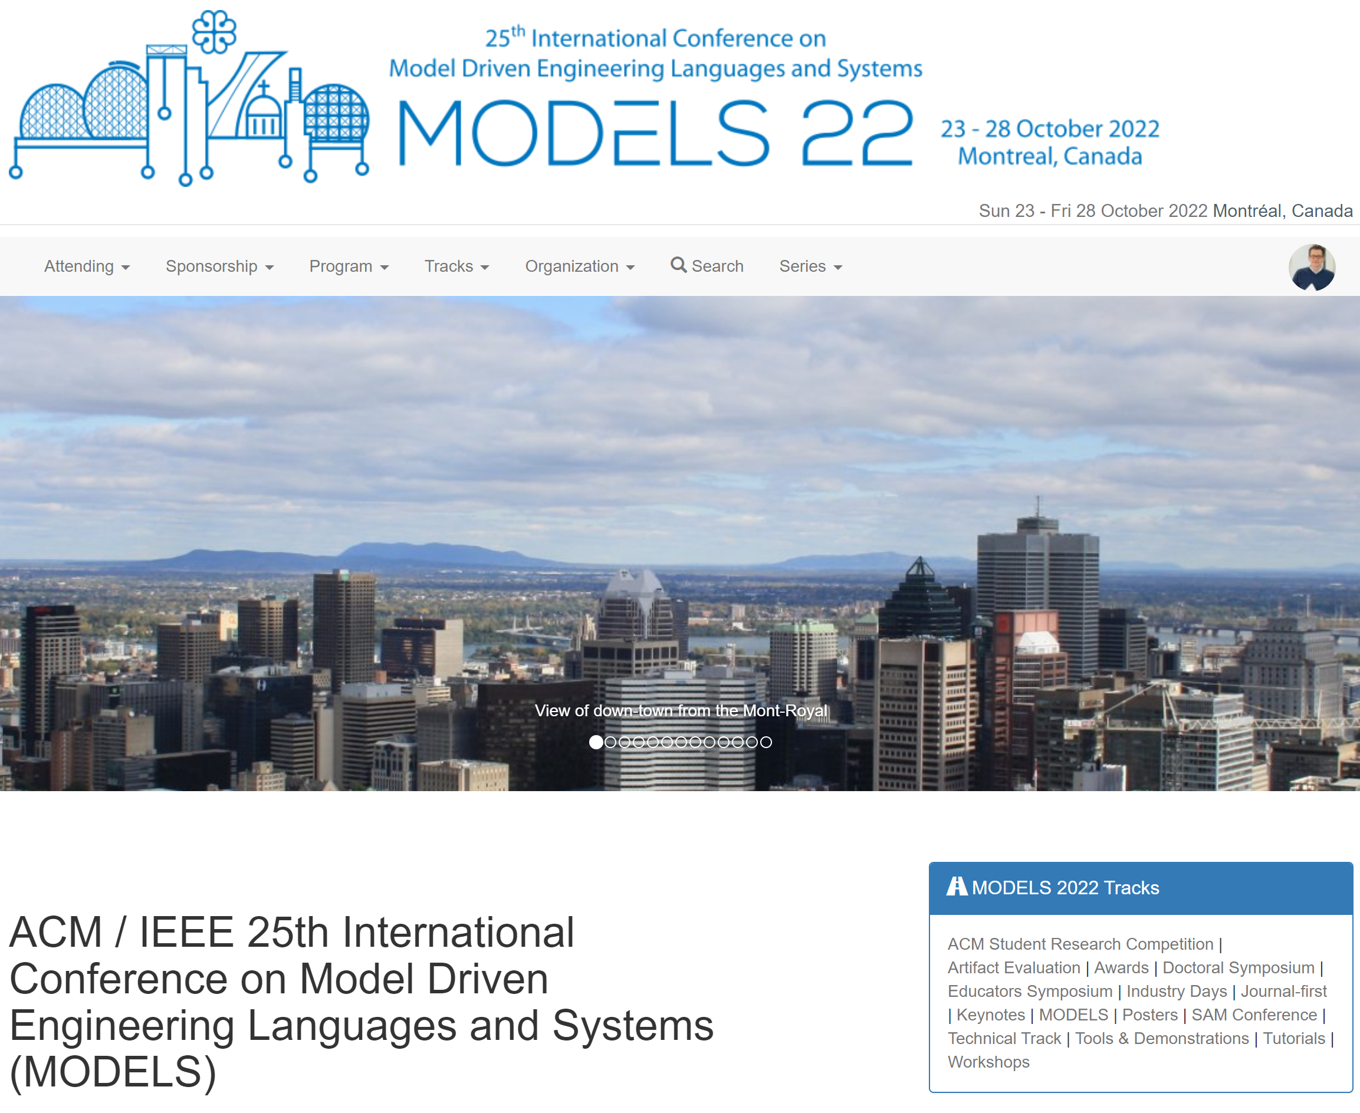

Slide 15
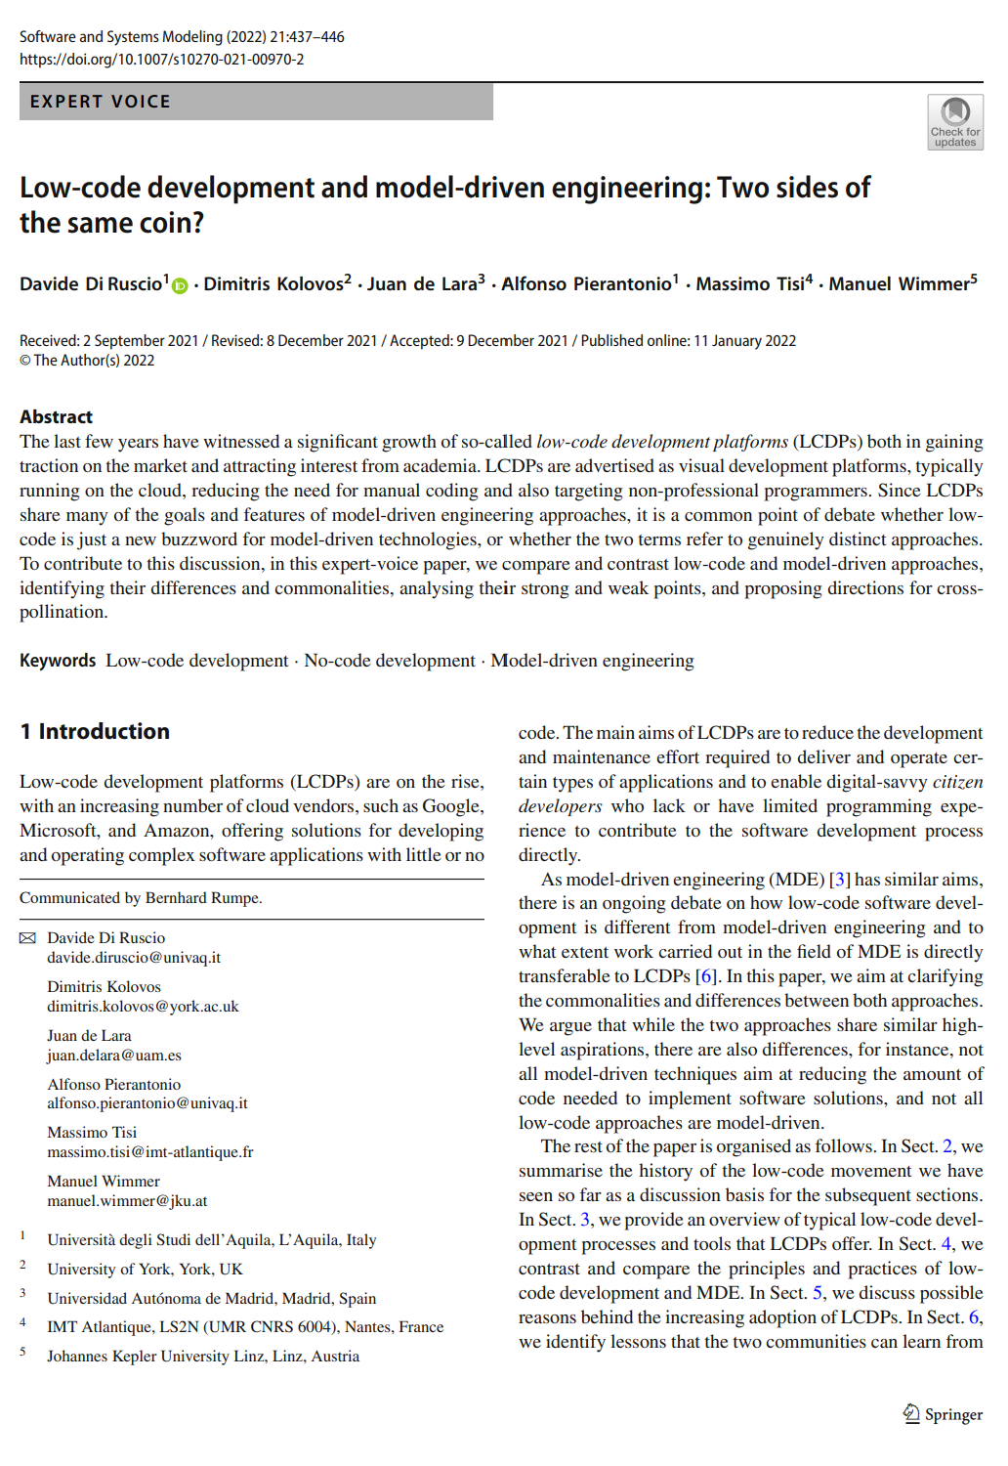

Slide 16
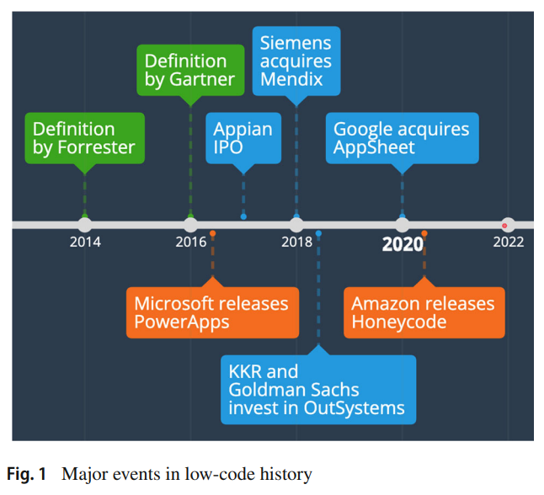
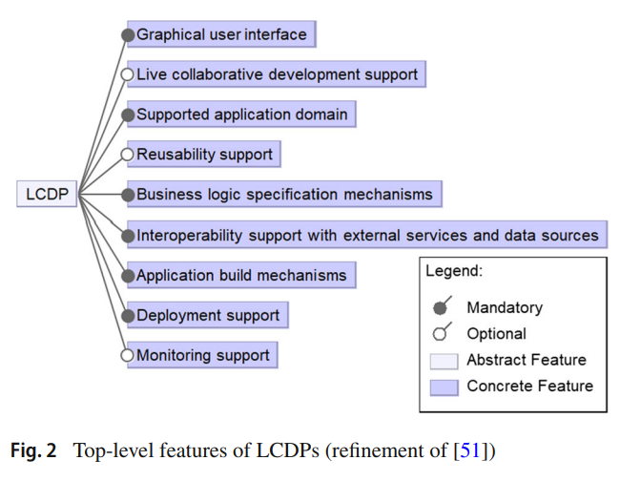
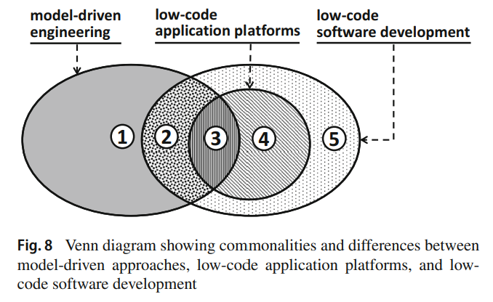
LCDP vs MDE

Slide 17
LCDP vs MDE
The goal of MDE is to increase productivity by automating different steps in software development employing models while augmenting the overall quality
LCDPs promote the construction of applications using forms and graphical editors with little or no hand-crafted code
    target users are citizen developers
    key point is to reduce accidental complexity regarding the installation and operation of both the development environments and the developed applications
LCDPs typically provide cloud-based development environments and manage the lifecycle of the designed applications

Slide 18
LCDP vs MDE
It contains the model-driven approaches that use models as machine-processable artefacts but do not aim at reducing the amount of code required to implement the system. Instea

Slide 19
LCDP vs MDE
Approaches that use models as machine processable artefacts and aim to reduce the amount of code required to implement a system (e.g. via code generation or interpretation) but without offering deployment or lifecycle management capabilities for the produced systems

Slide 20
LCDP vs MDE
Platforms that use models to facilitate the development of software applications with reduced code and offer built-in deployment and lifecycle management facilities for the produced application

Slide 21
LCDP vs MDE
Approaches offering built-in deployment and lifecycle management facilities for the produced application. They do not use models that conform to explicitly defined languages/metamodels

Slide 22
LCDP vs MDE
Approaches that aim to reduce the amount of code required to implement a system without offering deployment or lifecycle management capabilities for the produced system, without using models that conform to explicitly defined languages/metamodels

Slide 23
To conclude - main LCDP key points
Cloud-based deployment
Digital native workforce
Zero setup
Developer shortfall
Training facilities

