Slide 1


Using sequence-to-sequence neural networks to recommend cohesive API function calls
Claudio Di Sipio
Università degli Studi dell’Aquila / Italy
EMELIOT meeting 25-26 January 2023

Slide 2
Overview
Introduction
Motivating example
Proposed approach
Evaluation methodology
Results
Conclusion and discussion

Slide 3
Introduction
To implement the desired functionality, oftentimes, developers have to learn new APIs by consulting various sources
Unfortunately, these sources contain a lot of information, which renders developers overwhelmed, preventing them from approaching suitable APIs

Slide 4
Introduction
Even though a plethora of tools are already in place, only provide ranked list of APIs that are not strongly linked to the ongoing task
To cope with this, we conceive LUPE[*], a deep Learning seqUence-to-sequence based system to provide API rEcommendations by reformulating the problem as a cause-and-effect relationship
[*] Nguyen P .T., Di Sipio C., Di Rocco J., Di Ruscio D., Di Penta M., Fitting missing API puzzles with machine translation techniques, Expert Systems with Applications, 2022, DOI: 10.1016/j.eswa.2022.119477

Slide 5

Why ‘LUPE’?

Slide 6
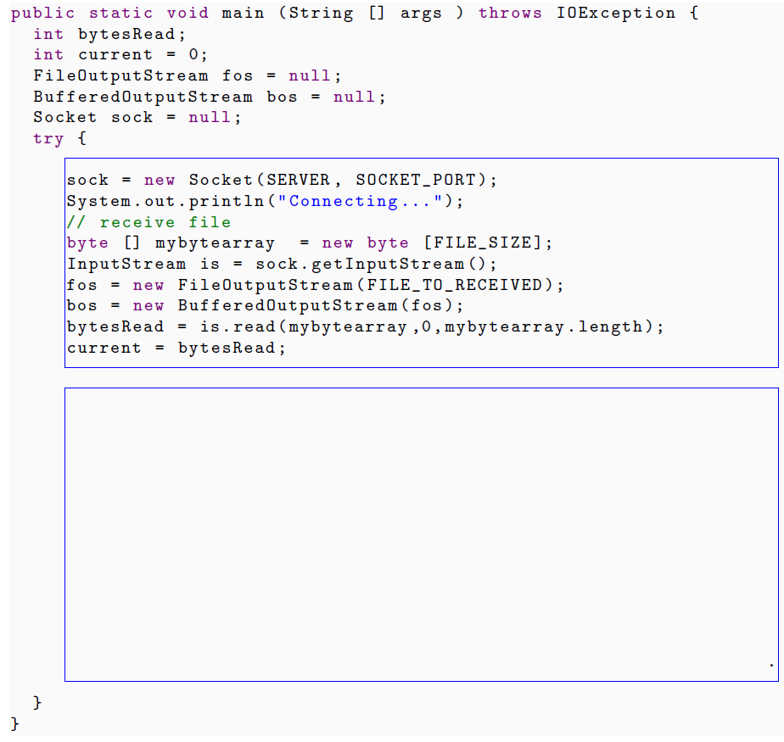
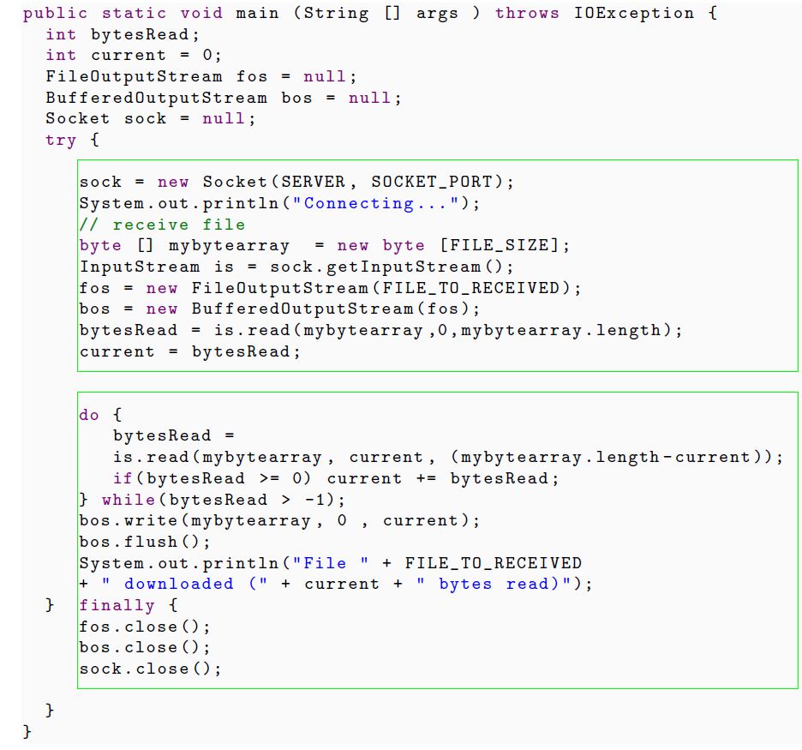
Motivating example
Original context
Expected result

Slide 7
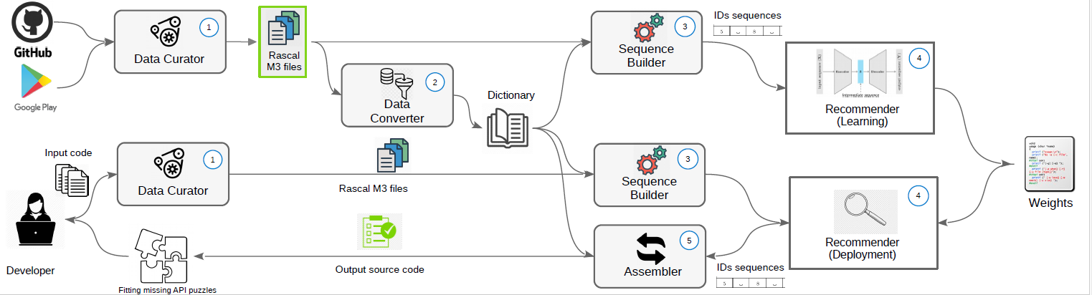
LUPE Architecture

Slide 8
API Declaration vs Invocation

Slide 9
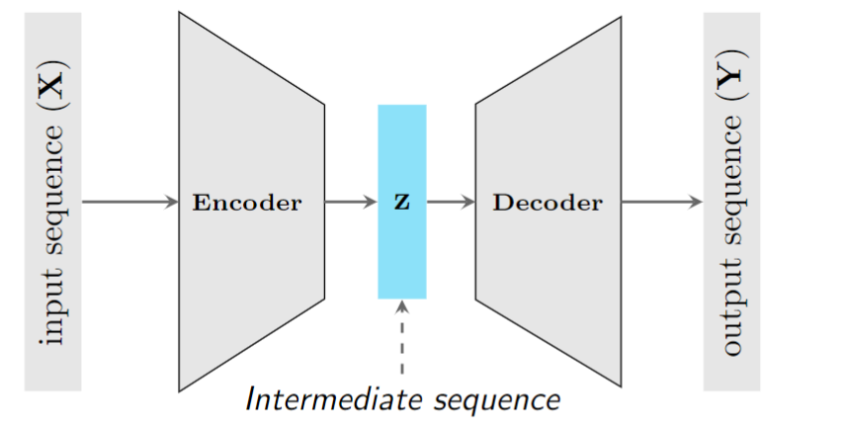
Sequence-to-sequence using LSTM
The Encoder-Decoder neural network is built on top of an atomic element called Long Short-Term Memory (LSTM)

Slide 10
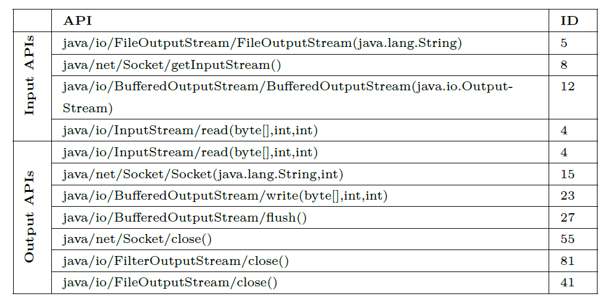
Data converter

Slide 11
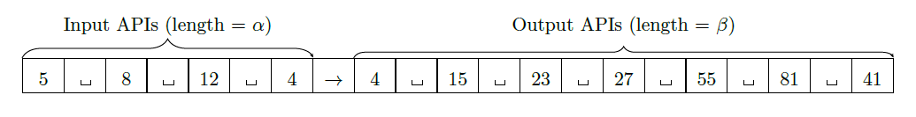
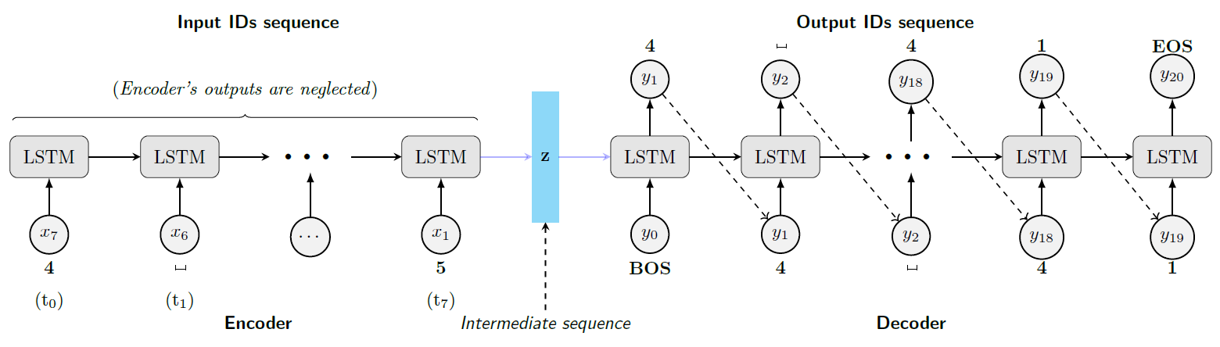
LUPE Sequence Encoder-Decoder

Slide 12
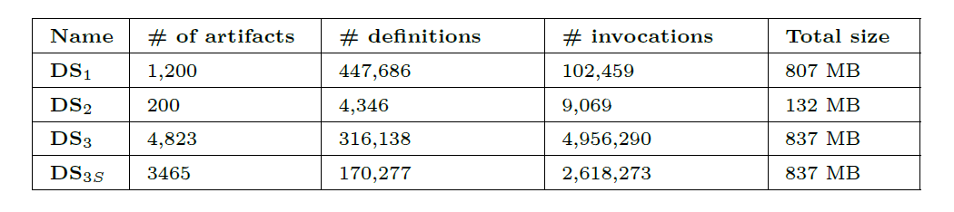
Evaluation: Datasets

Slide 13
Evaluation: Baselines
GAPI[*] suggests API usage by relying on a graph neural network with the GRU attention mechanism
FACER[**] combines clustering with frequent pattern strategy to retrieve a ranked list of API
[*] F. Liu, G. Li, Y. Zhao, and Z. Jin. Multi-task learning based pre-trained language model for code completion. In Proceedings of the 35th IEEE/ACM International Conference on Automated Software Engineering, ASE 2020
[**] S. Abid, S. Shamail, H. A. Basit, and S. Nadi. FACER: An API usage-based code-example recommender for opportunistic reuse. Empirical Software Engineering, 2021

Slide 14
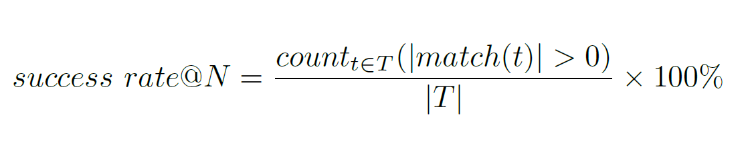
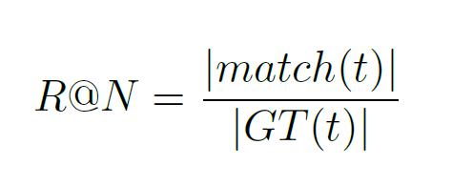
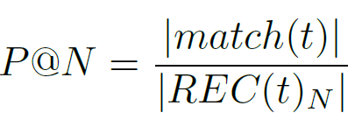
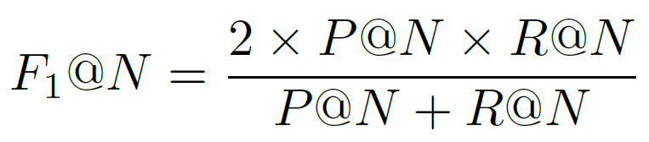
Evaluation: Accuracy metrics
REC(t)_{N} is the top-N recommended invocations for the testing definition
GT(t) is the number of invocation removed from a testing declaration t and used as a ground-truth data
Match(t) is the set of items in the top-N items list hat match with those in the ground-truth data

Slide 15
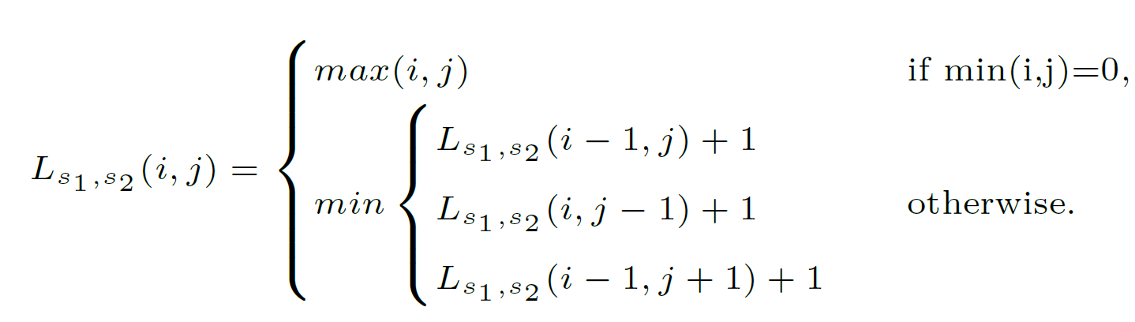
Evaluation: Levenshtein distance
Given two strings s1 and s2, the Levenshtein distance is computed as follows:
where i,j are the terminal character position.

Slide 16
Evaluation: Configurations
For each testing definition d_{t}, S_{t}=size(d_{t}) is the total number of API invocations of d_{t} and α the size of the query. Eventually, we elicit three configurations:
C₁ with α = round(S_{t}/3)
C₂ with α = round(S_{t}/2)
C₃ including invocations that appear at least ten times in the training data

Slide 17
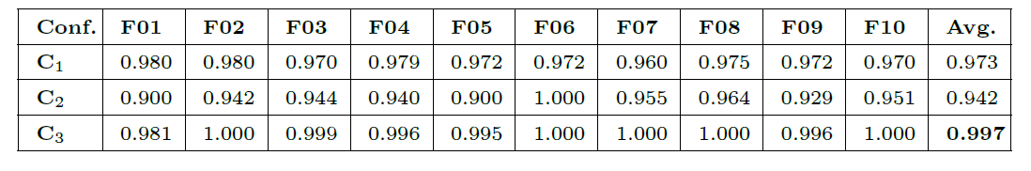
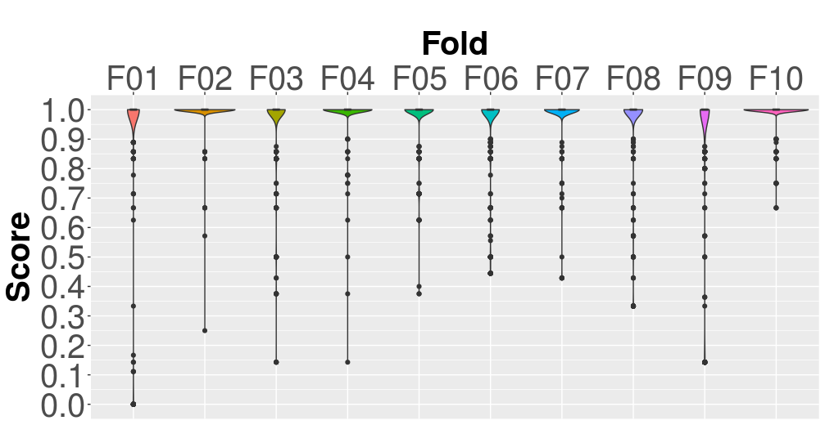
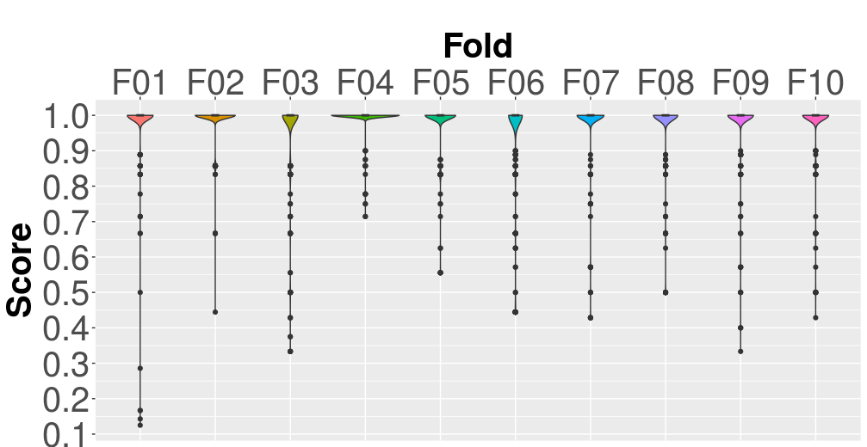
Results: Accuracy
Success rate values for all configuration
Precision values for C₃
Recall values for C₃

Slide 18
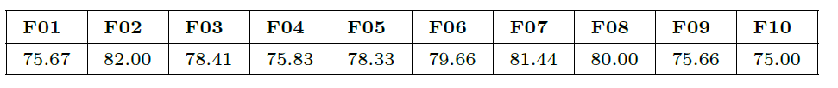
Results: Levenshtein distance
Percentage of definitions getting 0 as Levenshtein distance (%) considering C₃

Slide 19
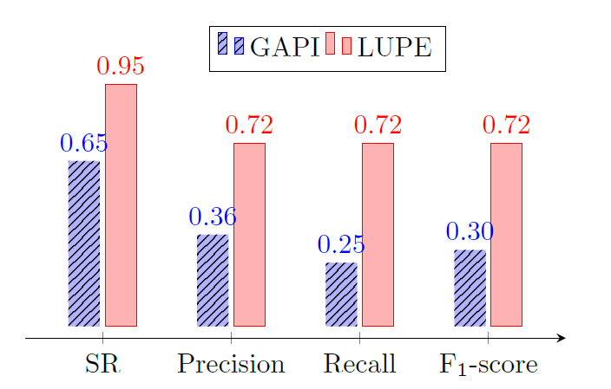
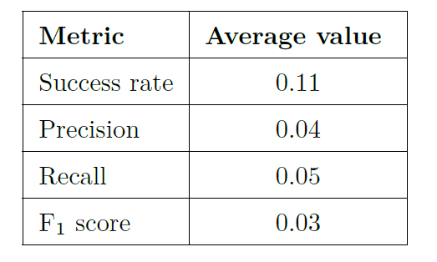
Results: Baselines
Comparison between GAPI and LUP on DS₂.
Results obtained by FACER on DS₂.

Slide 20
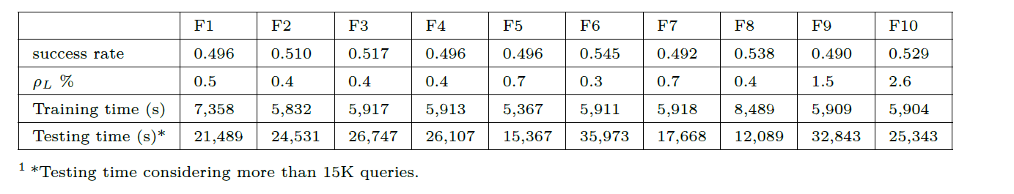
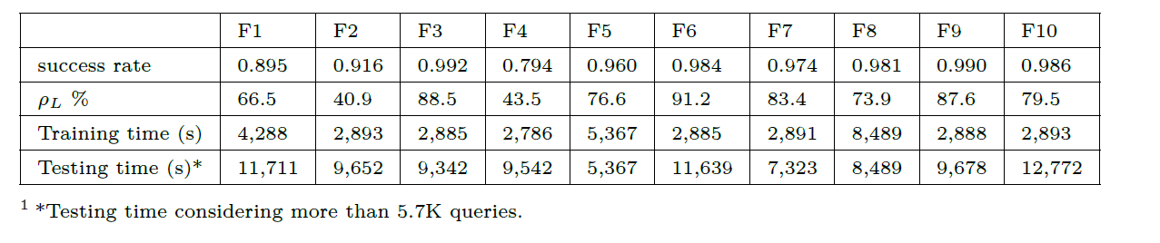
Results: Required time on DS₃ and DS3s

Slide 21
Conclusion
Contributions
A novel approach based on Encoder-Decoder neural network that recommends cohesive API invocations
It outperforms well-established baselines
Limitations
The training phase is time consuming
The quality of the data affects the predictions
No support for other languages , e.g., Python, C

Slide 22
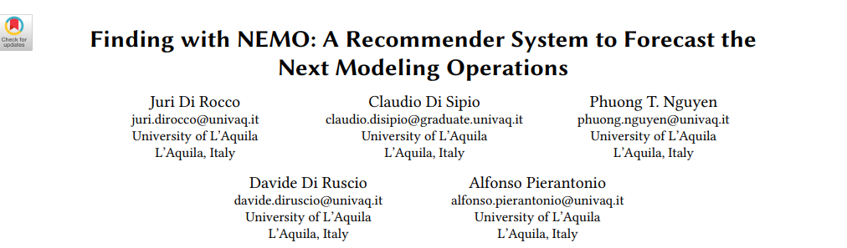
Discussion
In the frame of EMELIOT project, we can:
Reuse* the LSTM network in the IoT domain by recommending API functions for real devices, i.e. Arduino
Conduct an user evaluation using data collected from real devices

